Slide 1
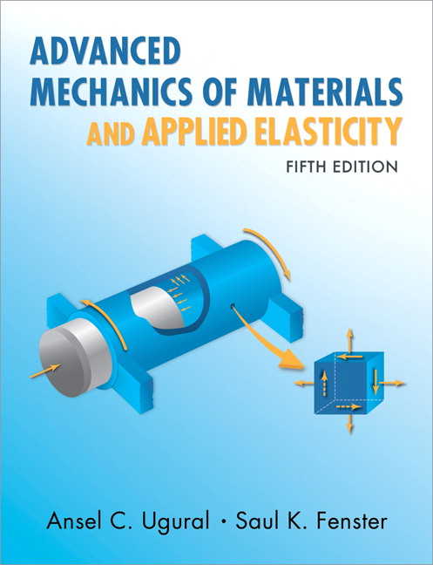
Advanced Mechanics
(Lecture 23)
ANNOUNCE / BUSINESS
HW 12 (due H, 4/10)
HW 11 is skipped
PREVIOUS
Reciprocity Theorem
TODAY
Questions?
Castigliano’s method

Slide 2



Castigliano’s Theorem
Derived approach to solve for deflections; can similarly find the slope at a point of interest (as long as a couple $C$ is applied there)
Strain energy is a function of axial load, moment, transverse load, and torque, all of which are functions of $P$
Since $P_{i}$ and $C_{i}$ are not functions of $x$, can move the derivative inside the integrals and use product rule:

Slide 3
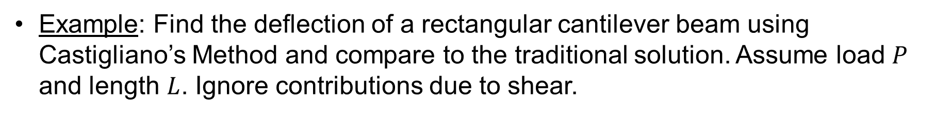
Castigliano’s Theorem
Example: Find the deflection of a rectangular cantilever beam using Castigliano’s Method and compare to the traditional solution. Assume load $P$ and length $L$. Ignore contributions due to shear.

Slide 4



Castigliano’s Theorem
Why did we ignore contributions due to shear?
Referring to Section 5.12 of text, recall that strain energy density due to shear can be expressed as
So strain energy is (Eq’n. 5.64)
Let . Then,

Slide 5

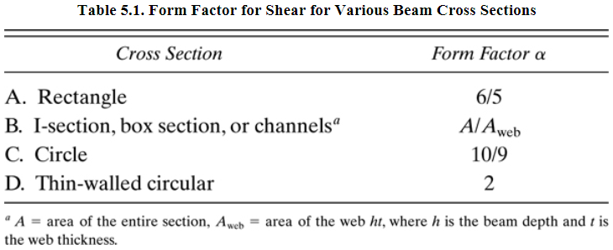
Castigliano’s Theorem
For a rectangular beam,
For other common shapes,

Slide 6


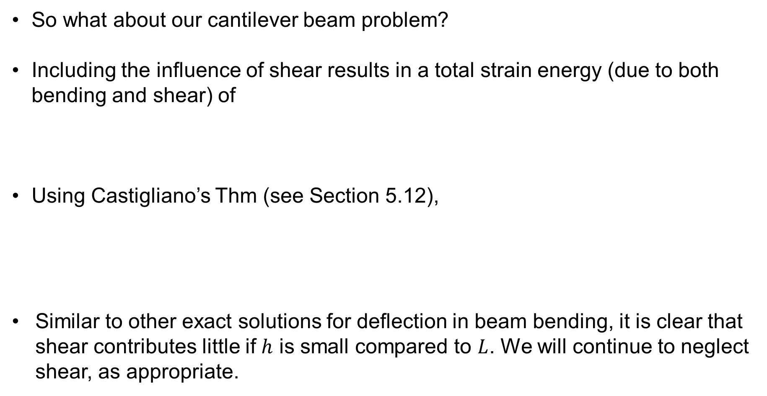

Castigliano’s Theorem
So what about our cantilever beam problem?
Including the influence of shear results in a total strain energy (due to both bending and shear) of
Using Castigliano’s Thm (see Section 5.12),
Similar to other exact solutions for deflection in beam bending, it is clear that shear contributes little if $h$ is small compared to $L$. We will continue to neglect shear, as appropriate.
(where $l=L$)

Slide 7
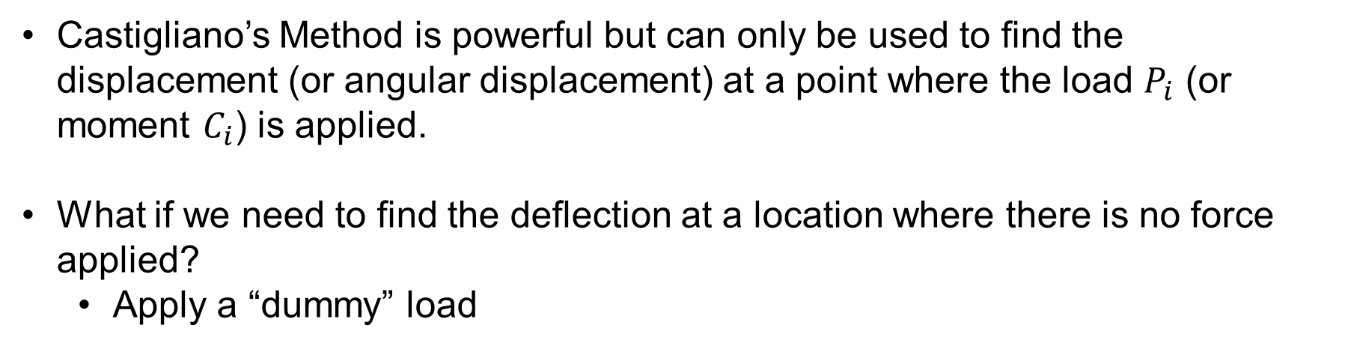
Dummy Loads
Castigliano’s Method is powerful but can only be used to find the displacement (or angular displacement) at a point where the load $P_{i}$ (or moment $C_{i}$) is applied.
What if we need to find the deflection at a location where there is no force applied?
Apply a “dummy” load

Slide 8
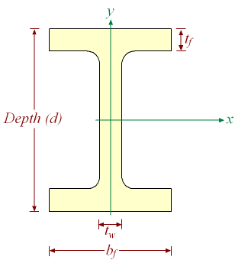



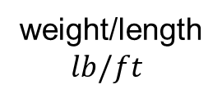

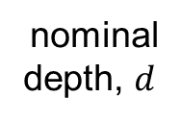


Dummy Loads
Example: Find deflection at $D$ in a beam with a wide-flange ($W10x15$) cross-section. Use $E=29x{10}^{6} psi$ and $I_{x}=69.9 {in}^{4}$.
nominal
depth, $d$
weight/length
$lb/ft$
$$ω=1.8 kip/ft$$
$$A$$
$$B$$
$$D$$
$$7.5’$$
$$12’$$

Slide 9
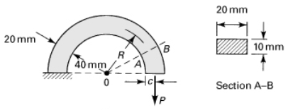
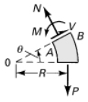
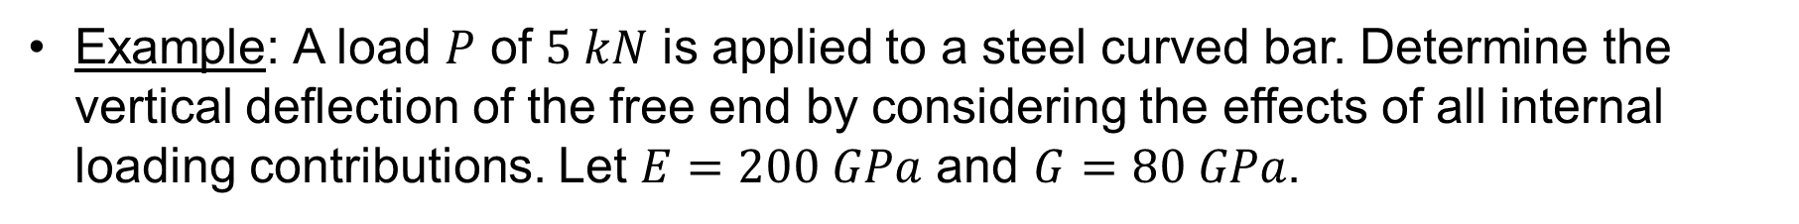
Castigliano’s Theorem
Example: A load $P$ of $5 kN$ is applied to a steel curved bar. Determine the vertical deflection of the free end by considering the effects of all internal loading contributions. Let $E=200 GPa$ and $G=80 GPa$.

Slide 10
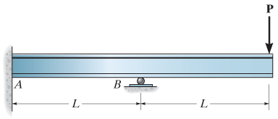
Statically Indeterminate Structures
Statically indeterminate = too many unknowns.
Approach to solve:
Choose one reaction to treat as known load.
Solve for deflection (or slope) at location of chosen reaction (using any of the methods we’ve discussed).
Set deflection (or slope) to zero and solve for load.

Slide 11
Indeterminate Structures
Castigliano’s can also be used to determine forces in indeterminate structures, knowing that displacement at the constraints has to be zero.
Approach: “Remove” one constraint and replace it with an unknown force (knowing the deflection is zero there). In our application of this method thus far, we have known the force but not the deflection. With this approach, we now don’t know the force, but we do know the deflection. There is still just one unknown.

Slide 12
Indeterminate Structures
$$ω$$
Example: Determine reactions at supports. Neglect the influence of shear loads.
$$A$$
$$B$$
$$C$$
$$L$$
$$L/2$$

Slide 13
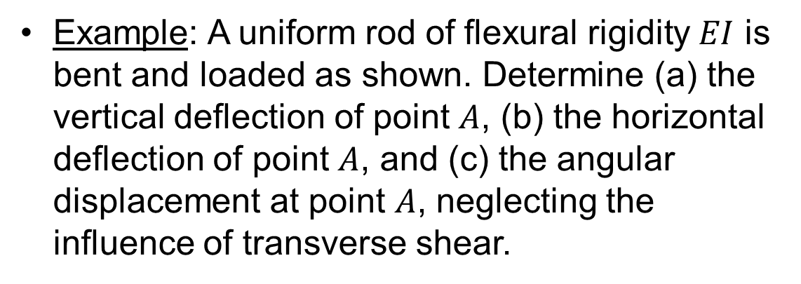
Example: A uniform rod of flexural rigidity $EI$ is bent and loaded as shown. Determine (a) the vertical deflection of point $A$, (b) the horizontal deflection of point $A$, and (c) the angular displacement at point $A$, neglecting the influence of transverse shear.

